Slide 1
Reversi

Slide 2
Member
ID | Name | Group
20110281 | Mohamed Ahmed Abd-elgawad | CS_3
20110335 | Mohamed Waleed Mohamed | CS_3
20110277 | Mohamed Ibrahim Mohamed | CS_3
20110432 | Ahmed Nasser Saleh | CS_4

Slide 3
Agenda
Project Descritption
Project design & The used tools.
Important lessons.

Slide 4
Project Description
What is Reversi
Which platform
How to play
What is the feature

Slide 5
Features
Playing against another player
top ten.
High score
listing online user

Slide 6
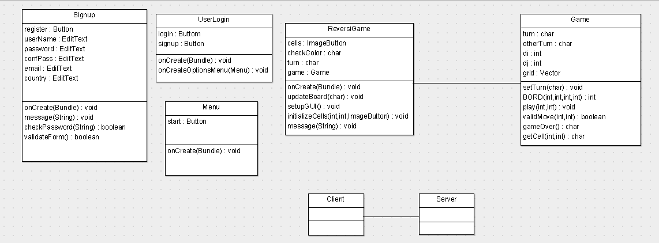
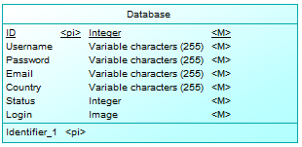
Project Design

Slide 7
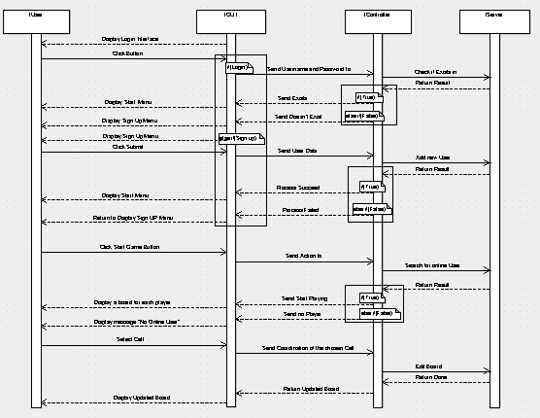

Slide 8
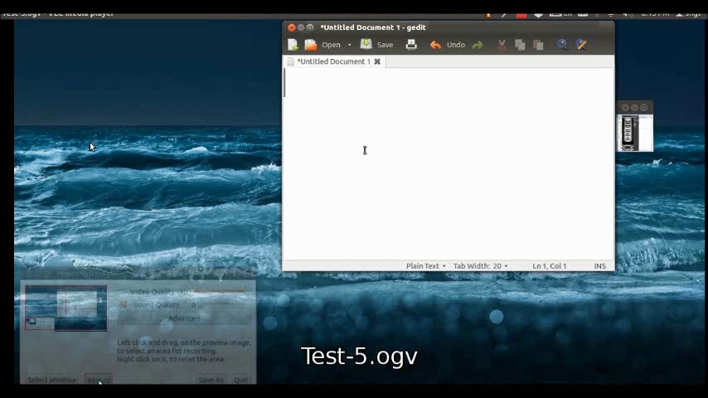

Slide 9
Used Tool
Android SDK
Eclipse IDE
Argo UML
Microsoft Project
Microsoft power Point
Screen Recorder
VLC :P
Movie Make
Photoshop
Wamp & easyPHP
Bitbucket & Trello
PDF Reader (Adobe Reader , Foxit , .. )

Slide 10
Important lesson
from project
Developing on android
Database
Server
PHP

Slide 11
Important lesson
from course
waterfall , agile
stand up meeting
sprints
Design
Notes:
Design :: UML , Sequence Digram , user story , use case , burn down chart
sprints :: divide project into tasks

Slide 12
3F

Slide 13
Thanks to Your Time
Thanks to Eng. Mustafa Saad
With Best Wishes ….

